Slide 1
Phonics for Parents Year 2

Slide 2
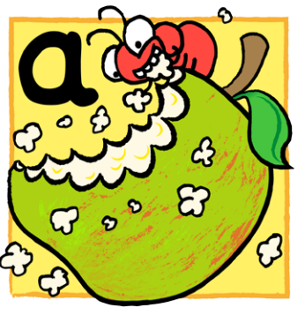
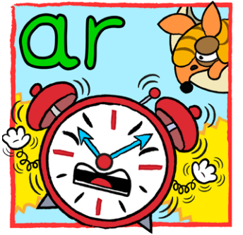
What is phonics?
A way of teaching reading and writing
Match letters to sounds and sounds to letters

Slide 3
Why Synthetic Phonics?
Is the proven method to achieve success for every child
Regardless of their age, gender, background, language profile or additional learning needs.

Slide 4
…but must
Be systematic, clearly defined, an incremental sequence
Give time to consolidate and apply their new knowledge

Slide 5
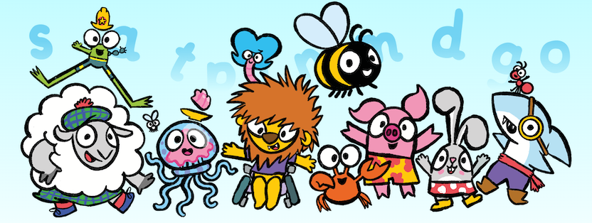
Phonics in St Joseph’s
First strategy for teaching reading and writing
Start of YR to Y3 (or as required)
High quality, regular phonics
Speaking, listening and games
Interactive
Application of learning
FUN!

Slide 6
Catchy, well aimed, fun!
My son has learnt to read within one year - all good!
Anima Phonics ‘Success Story’
Parent Survey
overwhelming positive
available on the school website
We’ve found it a fun way to learn, and keeps our children engaged and interested.
Really engaged him in reception.

Slide 7
Phonics in Year Two
Continuity:
Systematic:
Explicit:
Programme continues from YR & Y1
Regular teaching
Sequential order
Builds on prior learning
Direct teaching
Increasingly complex alphabetic code

Slide 8
Phonics in Year Two
Continuity:
Systematic:
Explicit:
Programme continues from YR & Y1
Regular teaching
Sequential order
Builds on prior learning
Direct teaching
Increasingly complex alphabetic code

Slide 9
Phonics in Year Two
Continuity:
Systematic:
Explicit:
Programme continues from YR & Y1
Regular teaching
Sequential order
Builds on prior learning
Direct teaching
Spelling rules
Increasingly complex phonics code

Slide 10
Phonics in Year Two
FOCUS 1:
Read and spell words
containing the sounds learnt
FOCUS 2:
Apply phonic knowledge to independent reading and writing

Slide 11
Phonics in Year Two
FOCUS 1:
Read and spell words
containing the sounds learnt
FOCUS 2:
Apply phonic knowledge to independent reading and writing

Slide 12
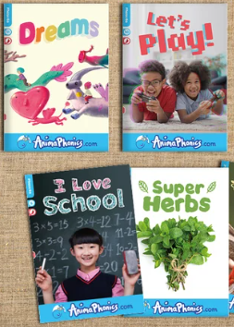
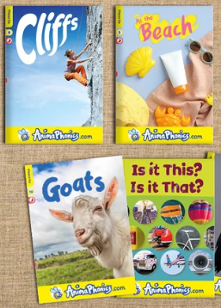
Phonics in Year Two
Reading:
mirrors phonics learning

Slide 13
Phonics in Year Two
Sessions:
Monday:
T, W & Th:
Friday:
5 / week
Recap
Intro focus sound
Reading & spelling
Sentences
3 x 15 minutes Practise & apply
Spelling test based on phonics learning

Slide 14
Phonics in Year Two
Sessions:
Monday:
T, W & Th:
Friday:
5 / week
Recap
Intro focus sound
Reading & spelling
Sentences
3 x 15 minutes Practise & apply
Spelling test based on phonics learning

Slide 15
Phonics in Year Two
Sessions:
Monday:
T, W & Th:
Friday:
5 / week
Recap
Intro focus sound
Reading & spelling
Sentences
3 x 15 minutes Practise & apply
Spelling test based on phonics learning

Slide 16
Phonics in Year Two
Sessions:
Monday:
T, W & Th:
Friday:
5 / week
Recap
Intro focus sound
Reading & spelling
Sentences
3 x 15 minutes Practise & apply
Spelling test based on phonics learning
Independent writing task

Slide 17
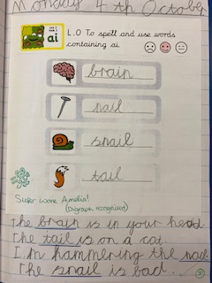
Main phonics lesson:
Recap previous sounds
Introduce a new sound
Practise reading and spelling words containing sound
Put words into simple sentences
Consolidate learning with independent writing

Slide 18
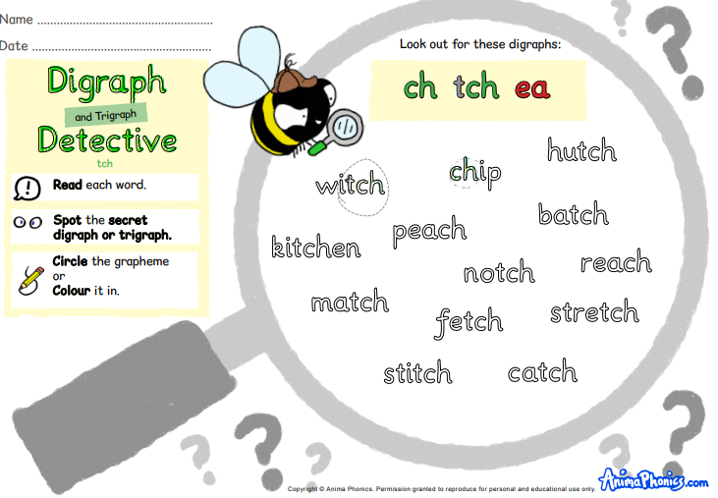
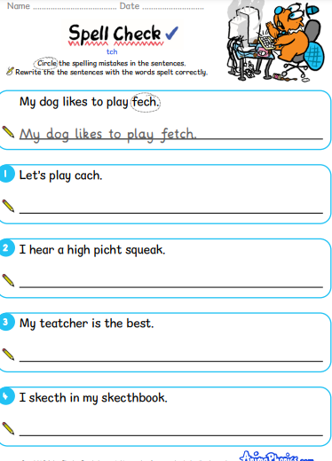
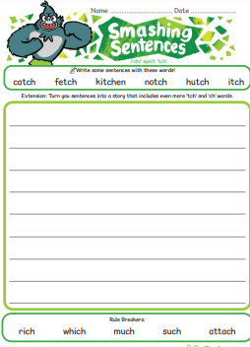
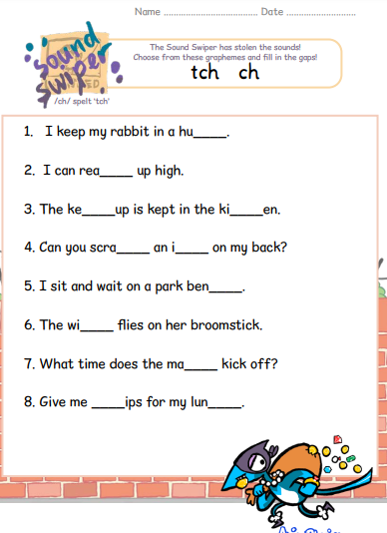
Tuesday, Wednesday, Thursday
Practise!

Slide 19
Last Phonics session
informal spelling test
focuses on the phonic sound of the week
independent writing task
apply phonics knowledge
practise weekly spellings

Slide 20
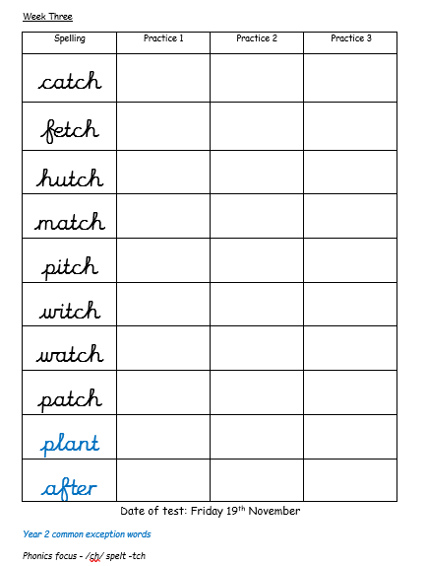
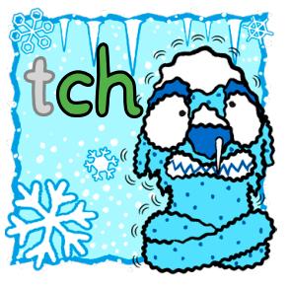
Weekly Spellings
Example:
Phonics focus
/ch/ spelt tch

Slide 21
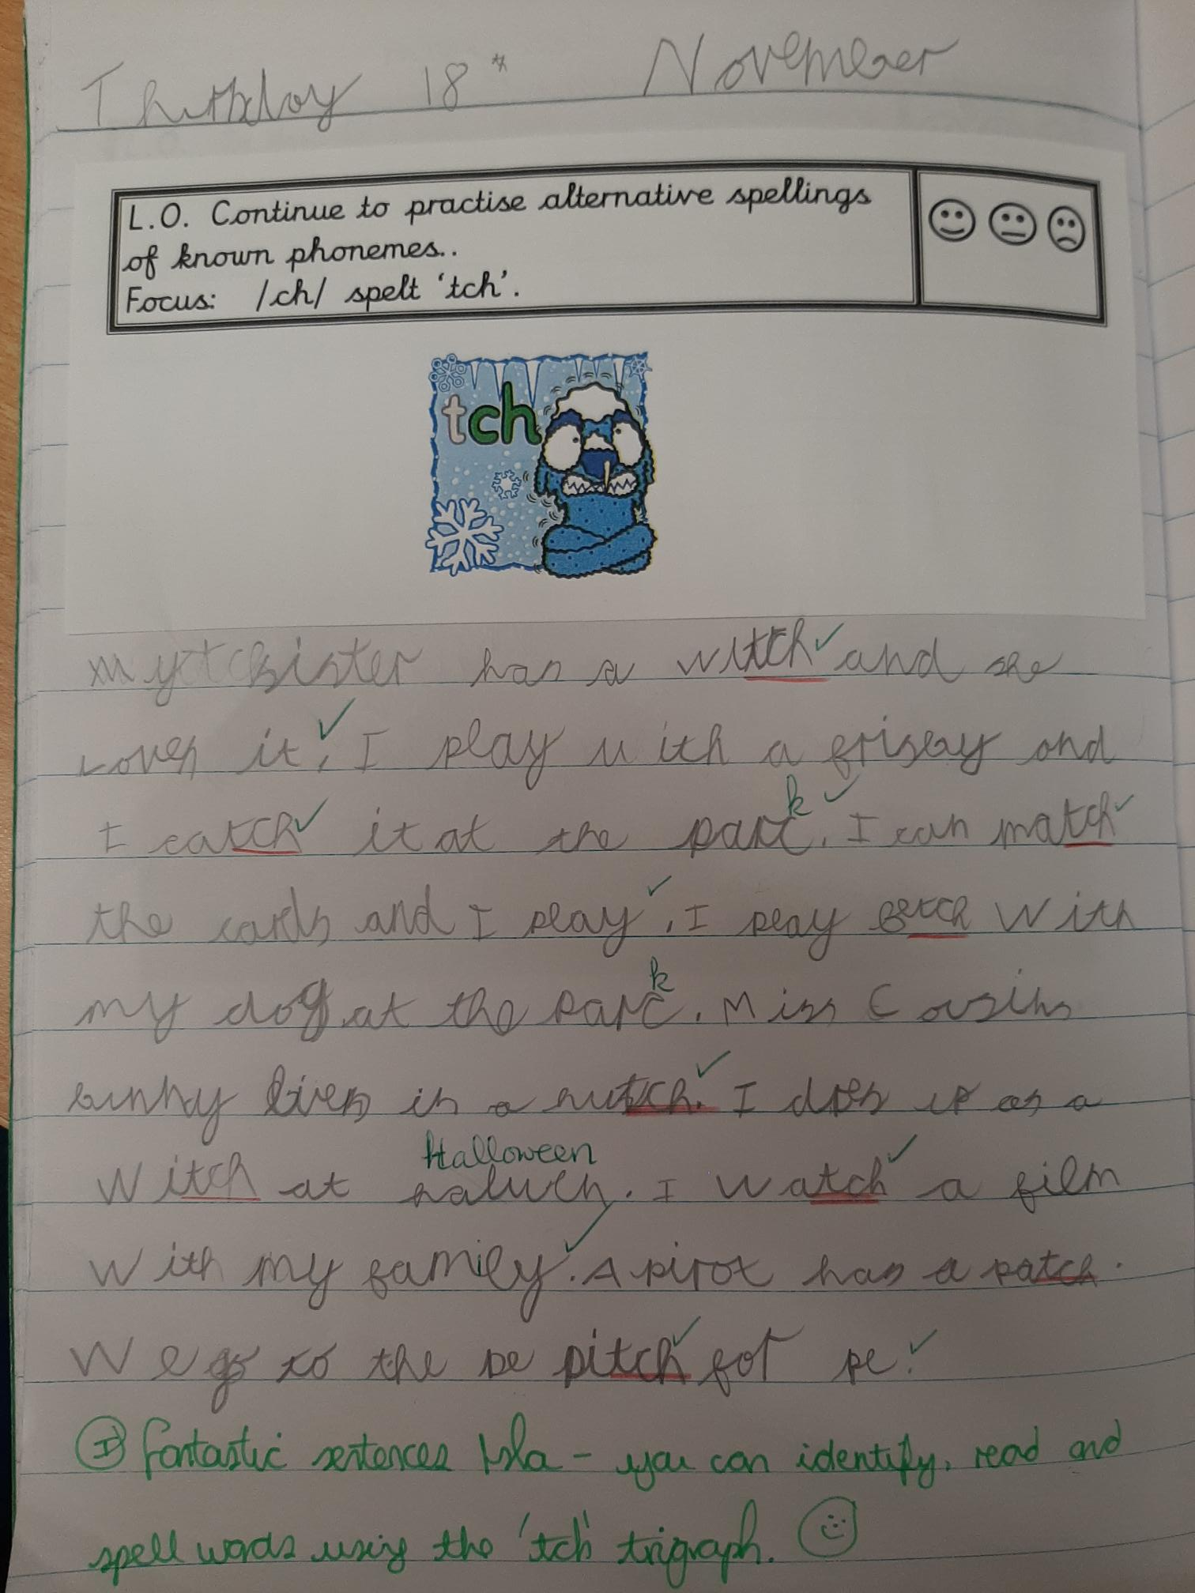
Independent writing task
to apply phonics knowledge in their writing
to practise weekly spellings by putting the words into sentences.

Slide 22
Y2 Phonics learning:
Continue to learn more silly sounds and unusual spellings

Slide 23
Y2 Phonics learning:
Continue to learn unusual spelling patterns and apply new spelling rules

Slide 24
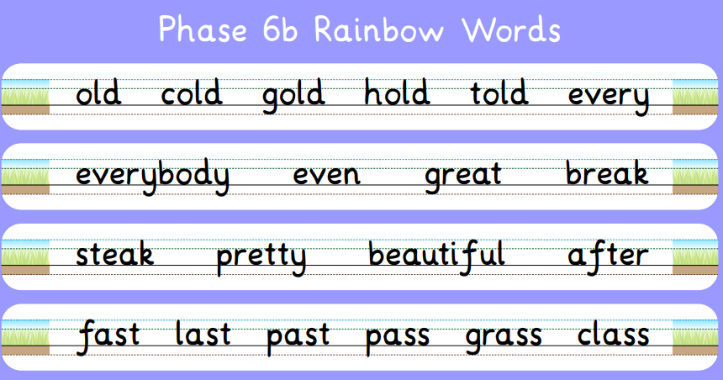
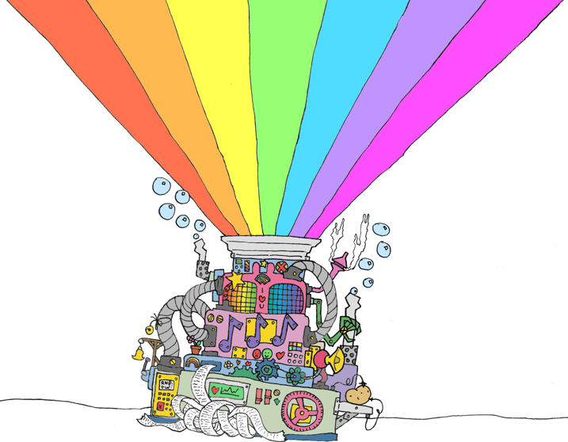
Y2 Phonics learning:
Continue to learn Rainbow Words

Slide 25
Phonics in Year Two
Alternative spellings for known graphemes, linked to spelling rules:
/igh/ – y (at the end of words: dry, July)
/s/ – c (before e, i, y : race, city, fancy) and so on…
Contractions: she’s, I’ve
Possessive apostrophe (singular nouns): Meg’s, the boy’s
Adding:
–es to nouns / verbs ending in y: flies, babies
-ed, -er, -est, -ing to root words ending in y: copied, happier, happiest, crying and so on…
Adding suffixes: -ment, -ness, -ful, -ly: enjoyment, sadness, playful, hopeless, badly
Homophones: hear / here
Rainbow words

Slide 26
MOST IMPORTANT
Practise
Reading
Spellings
Writing
Handwriting

Slide 27
Effective reading & writing
Good single word reading and writing is key: sounding out, blending, word building
Not just phonic knowledge
Memory: hold info across several sentences
Speech: talking in full sentences
Good vocabulary
Understanding
Ability to extract inferences

Slide 28
Effective reading & writing
Good single word reading and writing is key: sounding out, blending, word building
Not just phonic knowledge
Memory: hold info across several sentences
Speech: talking in full sentences
Good vocabulary
Understanding
Ability to extract inferences

Slide 29
Effective reading & writing
Good single word reading and writing is key: sounding out, blending, word building
Not just phonic knowledge
Memory: hold info across several sentences
Speech: talking in full sentences
Good vocabulary
Understanding
Ability to extract inferences

Slide 30
Effective reading & writing
Good single word reading and writing is key: sounding out, blending, word building
Not just phonic knowledge
Memory: hold info across several sentences
Speech: talking in full sentences
Good vocabulary
Understanding
Ability to extract inferences

Slide 31
Effective reading & writing
Good single word reading and writing is key: sounding out, blending, word building
Not just phonic knowledge
Memory: hold info across several sentence
Speech: talking in full sentences
Good vocabulary
Understanding
what is
being read
Ability to extract inferences

Slide 32
Effective reading & writing
Good single word reading and writing is key: sounding out, blending, word building
Not just phonic knowledge
Memory: hold info across several sentence
Speech: talking in full sentences
Good vocabulary
Understanding
what is
being read
Ability to extract inferences

Slide 33
Top Tips
Build it into
YOUR routine.
You learn the sounds, actions & spelling rules too!
Help and support.
TRY
not to get frustrated!
Listen regularly.
Make it
fun!

Slide 34
Help us create a love of reading…
Read words
Everywhere -
show that reading
has a purpose.
Share stories –
what are your favourite stories from childhood?
Bedtime stories
proven to help
build children’s vocabulary and understanding
– as well as
being lovely!
Become storytellers – make up stories together, act them out, draw it,
write it!
Talk! Talk! Talk!
Rhyme, patterns, new vocabulary.
Play with sounds and words.

Slide 35
Thank you!

Slide 36
Anima Phonics
https://www.animaphonics.com/
Soundboard – hear the sounds!
https://www.animaphonics.com/soundboard
Games – play games for free!
https://www.animaphonics.com/games

